Slide 1
Existential risk from artificial superintelligence
mod[ell]ed in Sid Meier's Civilization V
Shahar Avin
Centre for the Study of Existential Risk
sa478@cam.ac.uk

Slide 2
Outline
We care about the end of the world, so we made a Civ V mod.
What is Civ V?
What is a Mod?
What is Existential Risk?
What is Artificial Superintelligence?
Why we did it
How we did it
Results
Takeaways

Slide 3
What is Civ V?
Notes:
Sid Meier’s Civilization is a series of video game titles
Started 1991
Six titles to date: Civ V (2010), Civ VI (2016)
turn-based strategy
4X (eXplore, eXpand, eXploit, eXterminate)
Build a civilisation from prehistory to the near future
Manage cities, armies, diplomacy, research, economy, culture…
Victory types: conquest, diplomacy, science, culture

Slide 4
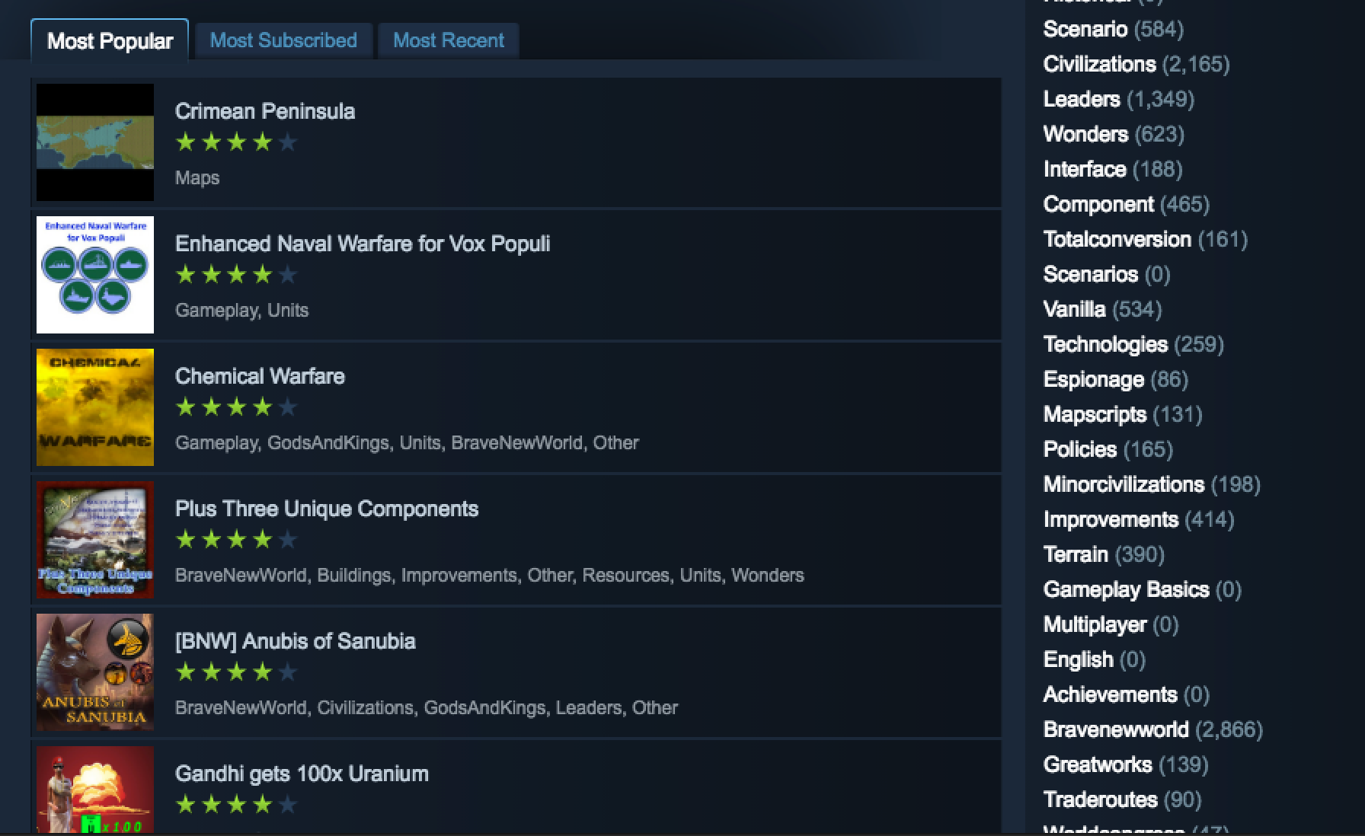
What is a mod?
Notes:
A modification of an existing game
Often created by the community of players, not the developers
Often relies on tools provided by the developer
Many kinds of mods: cosmetic, gameplay tweaks, maps, new games
Online marketplaces for sharing mods (e.g. Steam Workshop)
Civ V (and other civ titles) offers extensive modding support

Slide 5
What are Existential Risks?
Notes:
Risks of human extinction or permanent loss of potential
Natural vs Anthropogenic
Interdisciplinary
Low probability
Non-recurring

Slide 6
What is Artificial Superintelligence?
Notes:
Artificial Intelligence from calculators to AlphaZero
Narrow AI vs General AI
Exponential gain in capability, decisive strategic advantage
Instrumental goals
Orthogonality thesis
When accident risk becomes existential risk
Need to understand: coordination problems and race dynamics

Slide 7
Why create a Superintelligence mod for Civ?
As a model:
Open research questions in ASI strategy
Interplay with complex global systems
As a game:
Outreach and eduction
Player agency
Promote discussion
Recruit strategic minds
http://www.decisionproblem.com/paperclips/

Slide 8
Making of the mod
Roles: funder, project manager, developer
Concepts: artificial intelligence, superintelligence, existential risk
Process: iterative development, closed alpha, open beta

Slide 9
What’s in the mod
New victory and loss conditions
New technologies, buildings, wonder and specialists
New diplomacy options
Notifications, game events, statistics and graphs

Slide 10
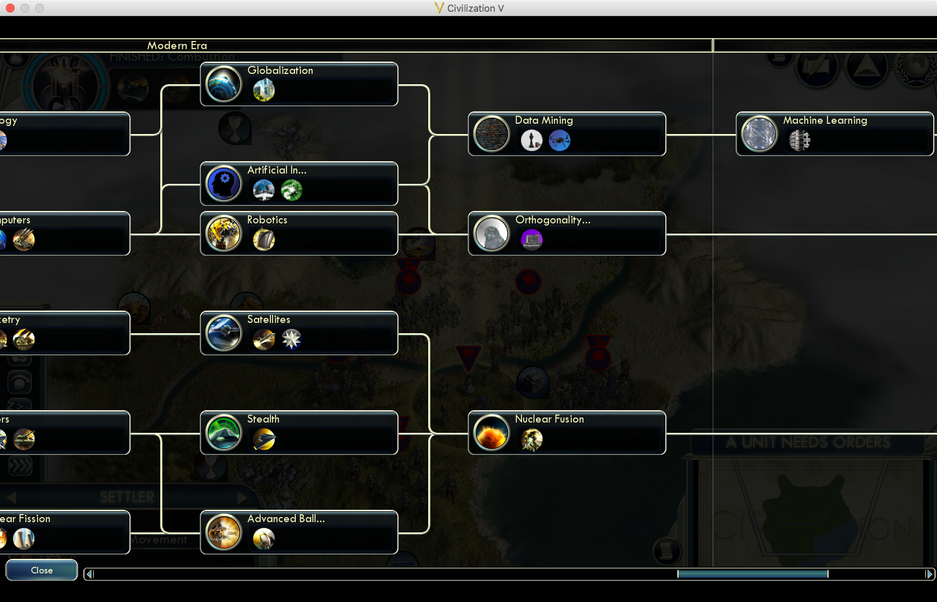

Slide 11
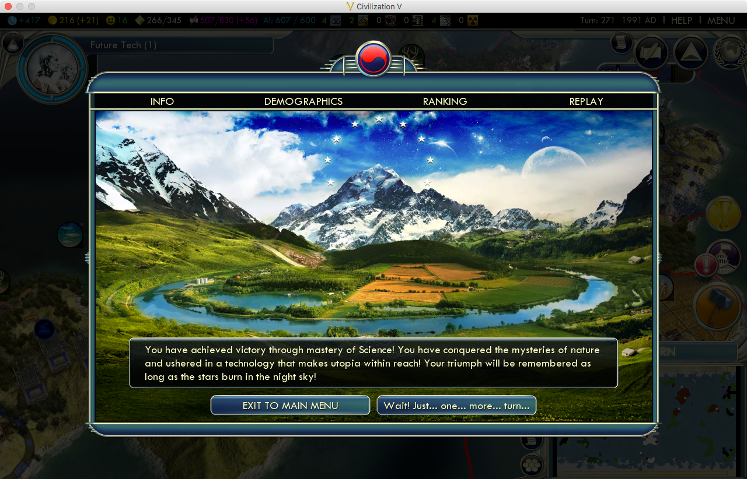

Slide 12
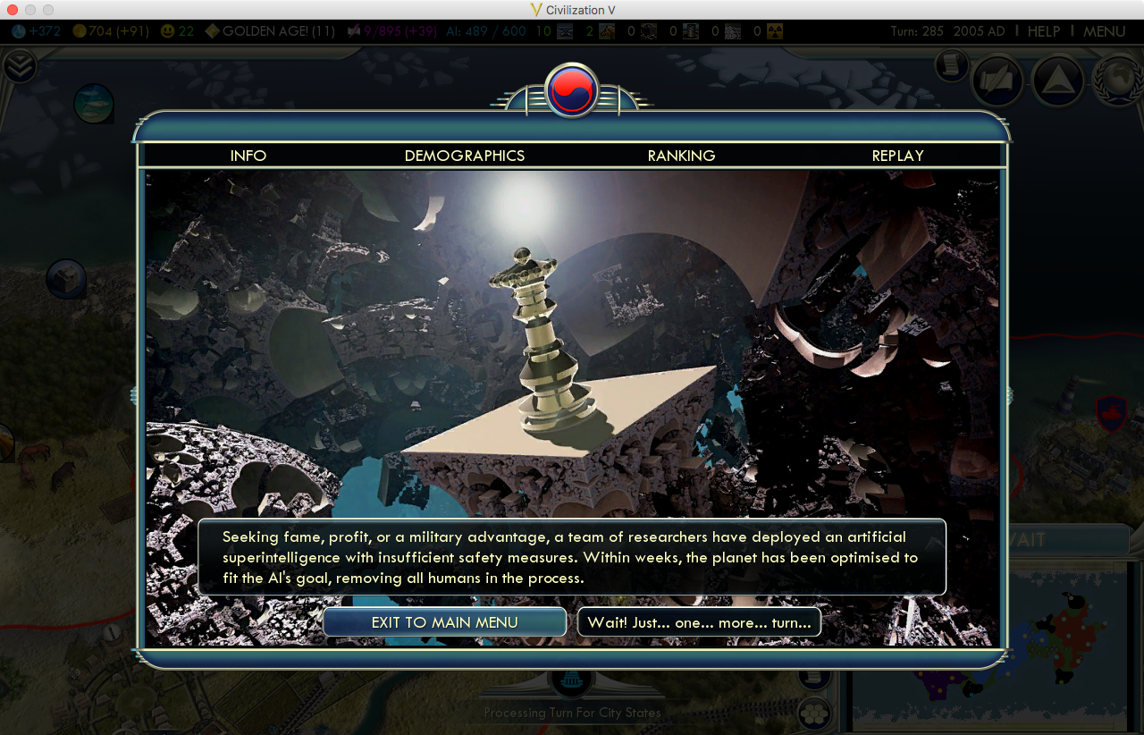

Slide 13
Results - media

Slide 14
Well played, PlayDome.hu…

Slide 15
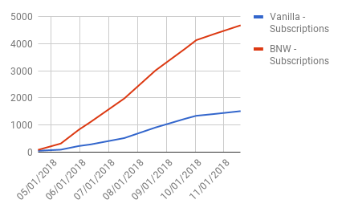
Results - players
25,000 visits
6,000 subscribers
4 star review

Slide 16
Discussion thread
“Idea: Make it so that you can fight the AI. It'd be really hard […] but I'm reasonably confident there'd be SOME abilty for humanity to resist somehow.” –Danwar
"Fighting the AI after it's escaped the box is Hollywood and misses the entire point of this mod.” –jgf1123
“It's not that unrealistic. […] Even if it was better than human generals, it would still only be a matter of time before another AI was designed to counter it. Fighting the AI isn't Hollywood, the AI instantly winning is.” – Canadian Hobbit
“@Canadian Hobbit, read Superintelligence by Nick Bostrom and tell me that it's possible to fight a fully fledged AI” – Maniacal Matt

Slide 17
Takeaways
Games can provide rich platforms for academic outreach
Game development as a process of conceptual clarification
Artificial Superintelligence as a global civilisational strategic issue
But…
Games come with limitations
Always convey more than intended
Need for an iterative process, lots of feedback

Slide 18
We invite you to play.
https://goo.gl/CzcEvw

